Slide 1

Managerial Ethics and SOCIAL RESPONSIBILITY
Guru srinivasan

Slide 2
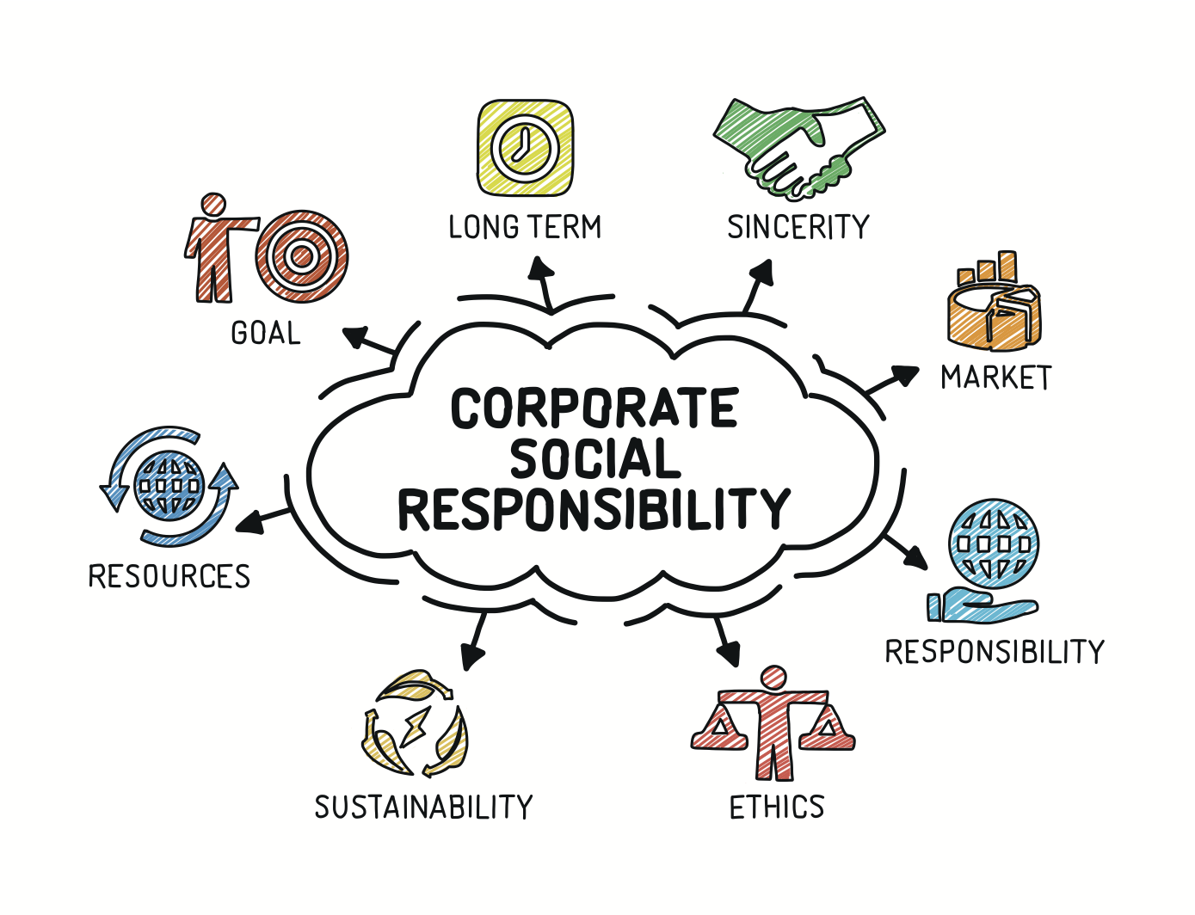
What is Corporate Social Responsibility?
It is a voluntary declaration of an organisation on their efforts towards social and environmental initiatives
According to Elkington (1960), the accountability of the organisation are towards the triple bottom line made of Planet, People, and Profits
These efforts are channelled towards improve corporate image

Slide 3
Society’s Expectations from Organizations and Managers
Managers regularly make decisions about issues with a social dimension
In competitive environment, organisations cannot afford to be seen as socially irresponsible

Slide 4
Relationship Between Social Responsibility and Economic Performance
Research studies show positive relationship
General public perception that companies who behave in a socially responsible way have better business performance

Slide 5
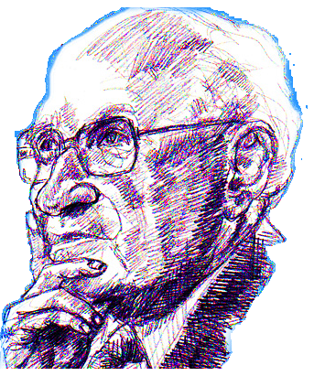
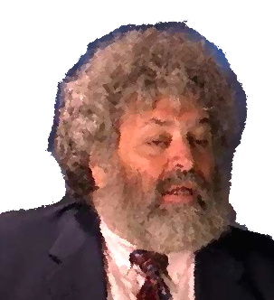
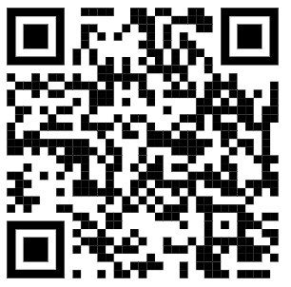
What Is Social Responsibility?
Two Opposing Views of Social Responsibility
Classical view - management’s only social responsibility is to maximise profits
Milton Friedman - managers’ primary responsibility is to serve the interests of the stockholders
doing “social good” adds to the cost of doing business
costs must be passed on to consumers
Socioeconomic view - businesses are not just economic institutions
According to Edward Freeman - management’s social responsibility goes beyond making profits to include protecting and improving society’s welfare
businesses have responsibility to a society that:
endorses their creation through laws and regulations
supports them by buying their products/services
more organisations around the world have increased their social responsibility
5-5

Slide 6
Carroll’s Pyramid
Philanthropic
Ethical
Legal
Economic
Philanthropic Responsibility: Responsibility towards being responsible towards society, planet and improve quality of life
Ethical Responsibility: Responsibility towards what is acceptable, just and fair
Legal Responsibility: Responsibility towards what is Right and Wrong
Economic Responsibility: Responsibility towards all stakeholders

Slide 7
Demonstrating Social Responsibility
Social Responsibility
A business firm’s intention, beyond its legal and economic obligations, to do the right things and act in ways that are good for society
Social Obligation
When a business firm engages in social actions because of its obligation to meet certain economic and legal responsibilities
Social Responsiveness
When a business firm engages in social actions in response to some popular social need

Slide 8
Managers Becoming More Socially Responsible
It is the collective behaviour and actions of managers that make a company socially responsible
Managers who make the right decisions are described as being or behaving ethically

Slide 9
Development of Ethics
Family
Life
Experiences
Friends
Individual
Ethics
Job
Experiences
Peers
Religion
Teachers

Slide 10

Managerial Ethics
Ethical dilemmas
The choice between two competing but arguably valid options
Rules and principles that define right and wrong conduct
Three Views of Ethics
Utilitarian view - ethical decisions are made on the basis of their outcomes or consequences
Moral Rights view - respects and protects individual liberties and privileges
Theory of justice view - managers impose and enforce rules fairly and impartially
Procedural justice
Distributive justice
Interactional justice
Commutative justice

Slide 11
Values
Basic convictions about what is right and wrong
Influence ethical behaviour
Values are developed in early years

Slide 12
Organisational Factors That Affect Ethical And Unethical Behaviour
Organizational
Culture
Moderators
Ethical/Unethical
Behaviour
Structural
Variables
Notes:
18

Slide 13

Moral Intensity in Ethical Decision Making
Moral intensity
The degree to which people see an issue as an ethical one

Slide 14
Moral Intensity in Ethical Decision Making
Magnitude of the consequences
Level of impact anticipated
Impact is independent of whether consequences are positive or negative
Magnitude of the
Consequences
Moral
Intensity
Adapted from Mullins (2017)
Adapted from Exhibit 2.4
Notes:
The magnitude of the consequences associated with the outcome of a given action is the level of impact anticipated.

Slide 15
Moral Intensity in Ethical Decision Making
Social consequences
The extent to which members of a society agree that an act is either good or bad
Population diversity weakens social consensus
Social
Consequences
Magnitude of the
Consequences
Moral
Intensity
Adapted from Mullins (2017)
Notes:
Social consensus involves the extent to which members of a society agree that an act is either good or bad.
Example: in the United States, there is greater social consensus concerning the wrongness of driving drunk than speeding on the highway.

Slide 16
Moral Intensity in Ethical Decision Making
Probability of effect
How likely people think the consequences are
The higher the probability of the consequence, the more intense the sense of ethical obligation
Social
Consequences
Magnitude of the
Consequences
Probability
of Effect
Moral
Intensity
Adapted from Mullins (2017)
Notes:
Probability of effect concerns the likelihood that a given consequence will in fact happen. The higher the probability of the consequence, the higher the moral intensity.

Slide 17
Moral Intensity in Ethical Decision Making
Temporal immediacy
Interval between the time the action occurs and the onset of its consequences
The greater the time interval, the less intensity people typically feel toward the issue
Social
Consequences
Magnitude of the
Consequences
Probability
of Effect
Moral
Intensity
Temporal
Immediacy
Adapted from Mullins (2017)
Adapted from Exhibit 2.4
Notes:
Temporal immediacy is a function of the interval between the time an action occurs and the onset of its consequences. The greater the time interval between the action and its consequences, the less intensity people typically feel toward the issue.

Slide 18
Moral Intensity in Ethical Decision Making
Proximity
The closeness the decision maker feels to those affected
Closeness leads to more consideration of the consequences
Closeness increases feeling that it has ethical implications
Social
Consequences
Magnitude of the
Consequences
Probability
of Effect
Moral
Intensity
Temporal
Immediacy
Proximity
Adapted from Mullins (2017)
Notes:
Proximity is concerned with the individual’s physical and psychological closeness to the outcome. The closer the decision maker is or feels to those affected by the decision, the more the decision maker will consider the consequences of the action and feel it has ethical implications.

Slide 19
Moral Intensity in Ethical Decision Making
Concentration of effect
Focus of effect on only a few or disbursed across many individuals
Higher concentration leads to feelings of greater ethical responsibility
Social
Consequences
Magnitude of the
Consequences
Probability
of Effect
Moral
Intensity
Concentration
of Effect
Temporal
Immediacy
Proximity
Adapted from Mullins (2017)
Notes:
The concentration of effect is the extent to which consequences are focused on a few individuals or dispersed across many. The higher the concentration of effect, the high the moral intensity.

Slide 20
Code of Ethics
Formal statement of an organisation’s primary values and ethical rules it expects employees to follow
Usually written
Must state in detail acceptable behaviours and actions

Slide 21
Successfully Implementing Codes of Ethics
Implementing a Code of Ethics
Reward & Recognition
Whistle-blowing
Communication
Training

Slide 22
Thank You

